Slide 1

CHAPTER 19
State Machine Design with SM charts
This chapter in the book includes:
Objectives
19.1 State Machine Charts
19.2 Derivation of SM Charts
19.3 Realization of SM Charts

Slide 2


Slide 3
Recap of the previous Home work(chap 16, pr17)
-iterative circuit: Fig 16-6 & 16-9
State diagram is given for the problem
Design a typical cell and output circuit
Specify a1 and b1 and simplify the first cell
Show how a sequential circuit can be constructed
using the typical cell and output circuit

Slide 4
Objectives
Topics introduced in this chapter:
19.1 Explain the different parts of an SM chart
19.2 Given the input sequence to a state machine,determine the output sequence from its
SM chart and construct a timing diagram.
19.3 Convert a state graph to an SM chart.
19.4 Construct an SM chart for the control circuit for a multiplier,divider,or other simple
digital system.
19.5 Determine the next-state and output equations for a state machine by tracing link
paths on its SM chart.
19.6 Realize an SM chart using a PLA,or ROM and flip-flops.

Slide 5
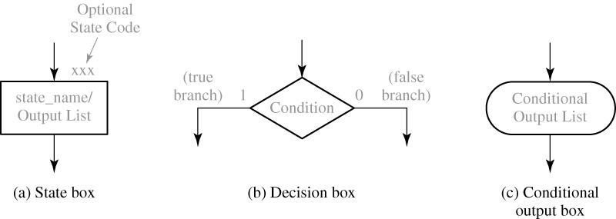
19.1 State Machine Charts
Figure 19-1: Components of an SM Chart

Slide 6
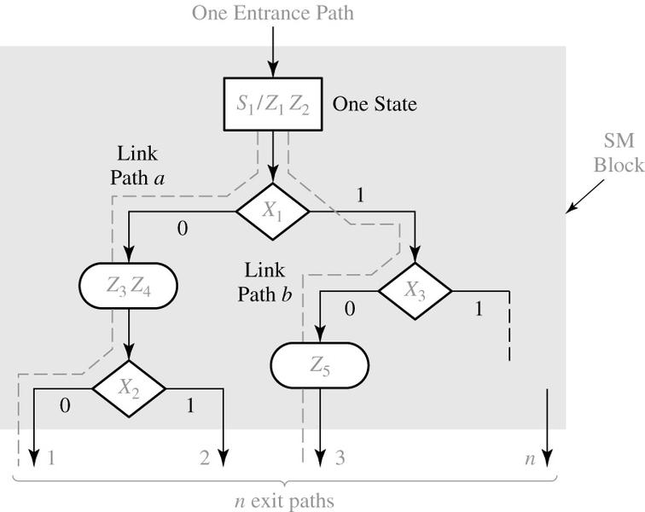
19.1 State Machine Charts
Figure 19-2: Example of an SM Block

Slide 7
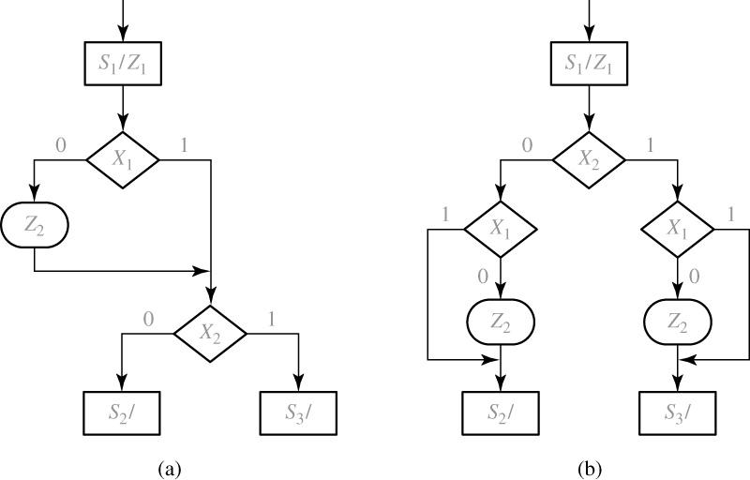
19.1 State Machine Charts
Figure 19-3: Equivalent SM Blocks

Slide 8
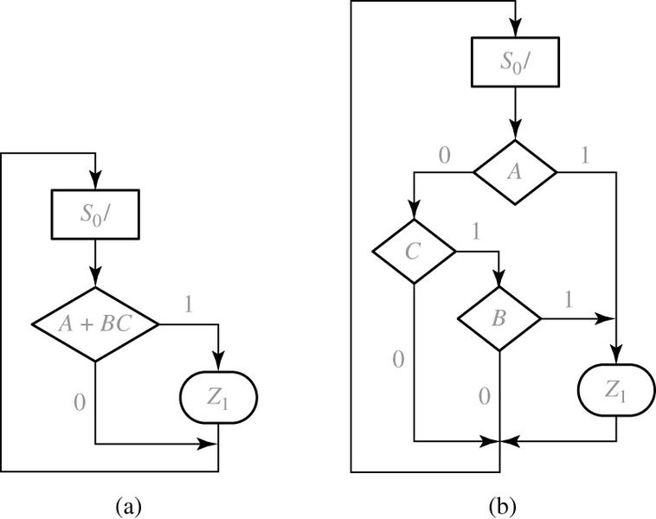
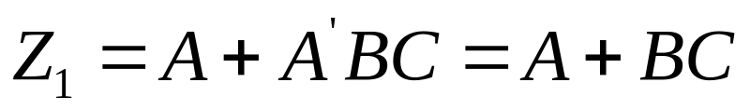
19.1 State Machine Charts
Figure 19-4: Equivalent SM Charts for a Combinational Circuit

Slide 9
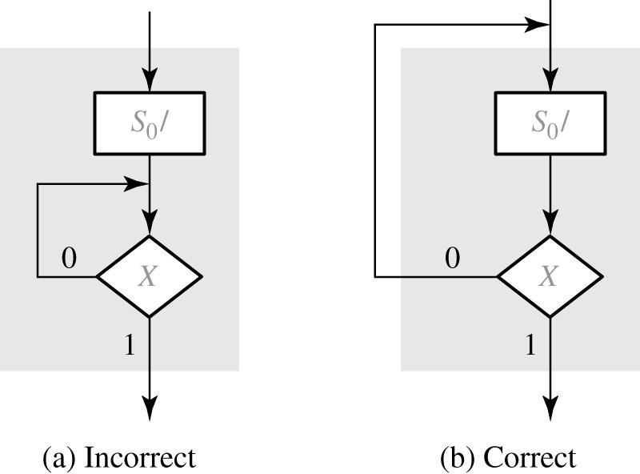
19.1 State Machine Charts
Figure 19-5: SM Block with Feedback

Slide 10
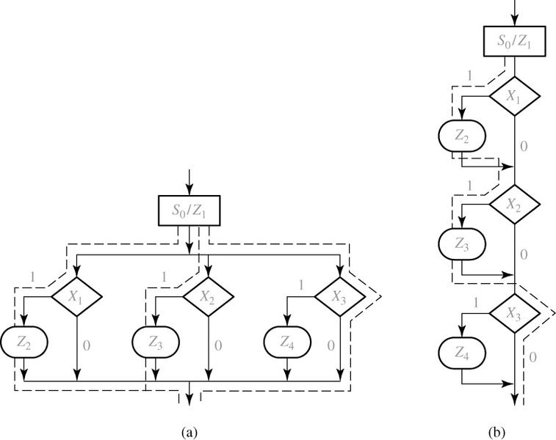
19.1 State Machine Charts
Figure 19-6: Equivalent SM Blocks

Slide 11
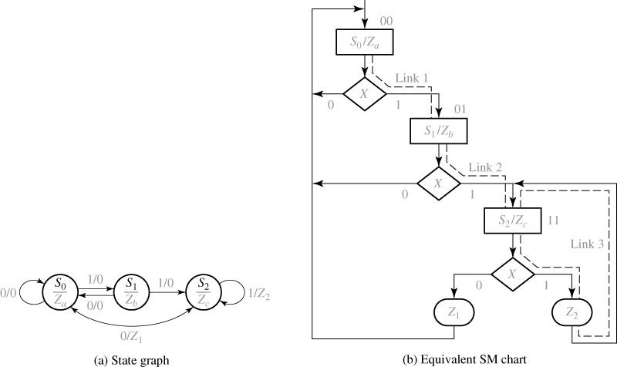
19.1 State Machine Charts
Figure 19-7: Conversion of a State Graph to an SM Chart

Slide 12
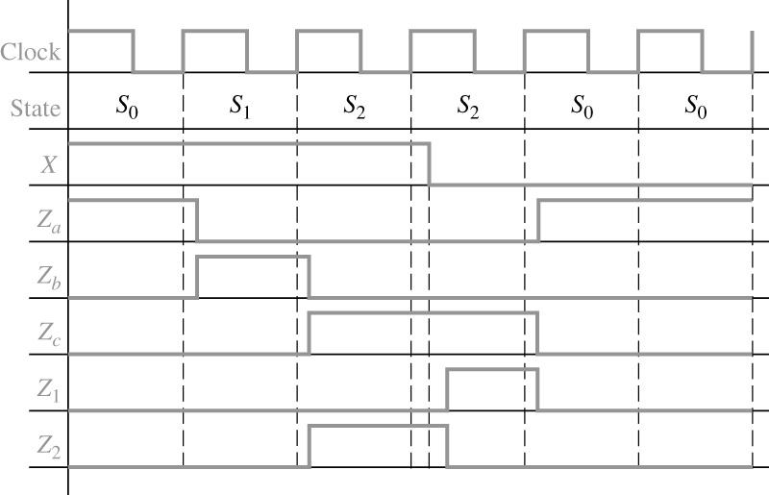
19.1 State Machine Charts
Figure 19-8: Timing Chart for Figure 19-7
With a input sequence 1,1,1,000 all state changes(Moore machine)
occur immediately after the rising edge of the clk.
Mealy outputs(z1, Z2) can change immediately after a state change
or an input change

Slide 13
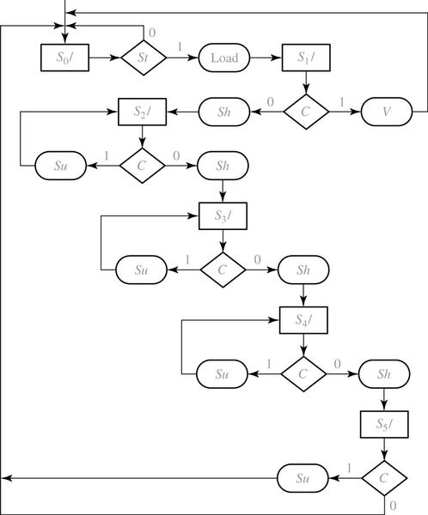
19.2 Derivation of SM Charts
Figure 19-9: SM Chart for Binary Divider: similar to Fig 18-11

Slide 14
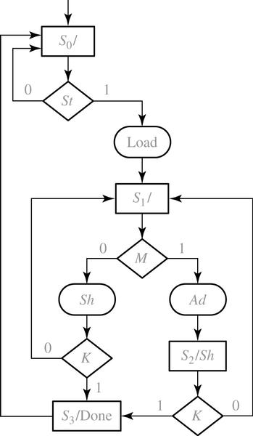
19.2 Derivation of SM Charts
Figure 19-10: SM Chart for Binary Multiplier: similar to Fig 18-9a

Slide 15
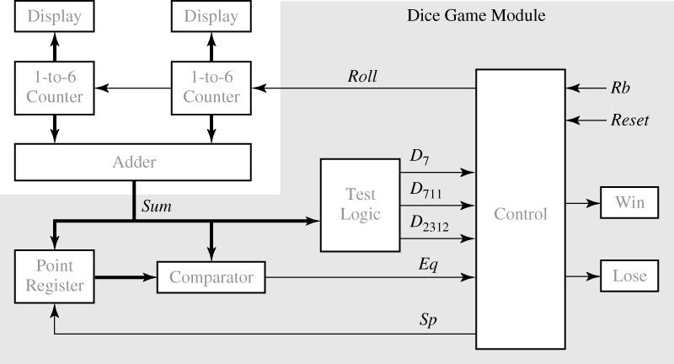
19.2 Derivation of SM Charts
Figure 19-11: Block Diagram for dice Game

Slide 16
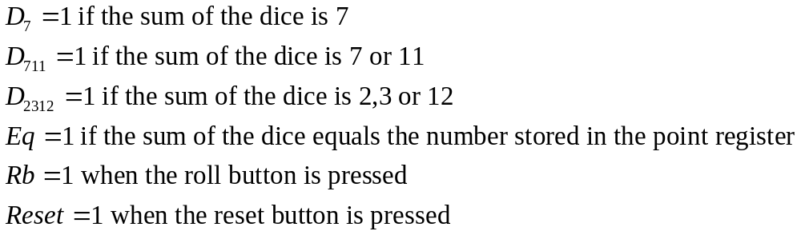
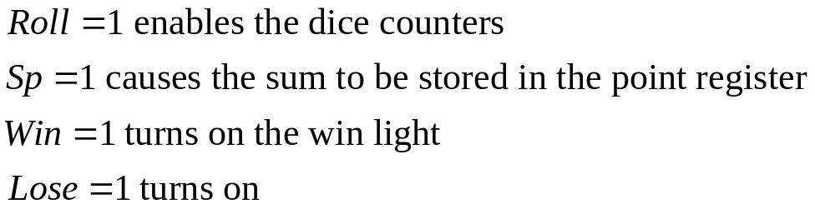
19.2 Derivation of SM Charts
1. After the first roll of the dice, the player wins if the sum is 7 or 11.
He loses if the sum is 2, 3 or 12. Otherwise, the sum which he obtained
on the first roll is referred to as his point, and he must roll the dice again
2. On the second or subsequent roll the dice, he wins if the sum equals his point,
and he loses if the sum is 7. Otherwise, he must roll again until he finally wins
or loses.
The input signals to the control circuit are defined as follow
The output from the control circuit are defined as follows:

Slide 17
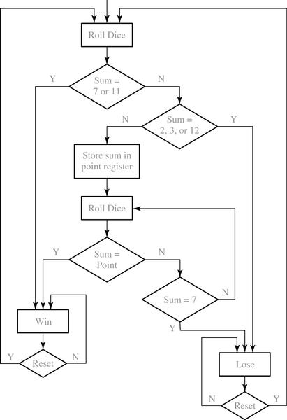
19.2 Derivation of SM Charts
Figure 19-12: Flowchart for Dice Game

Slide 18
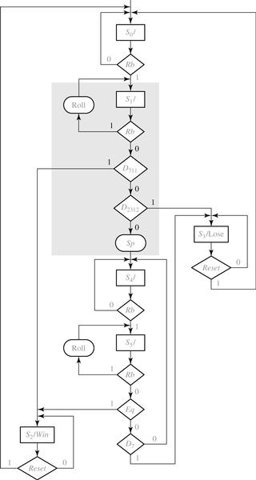
19.2 Derivation of SM Charts
Figure 19-13: SM Chart for Dice Game

Slide 19
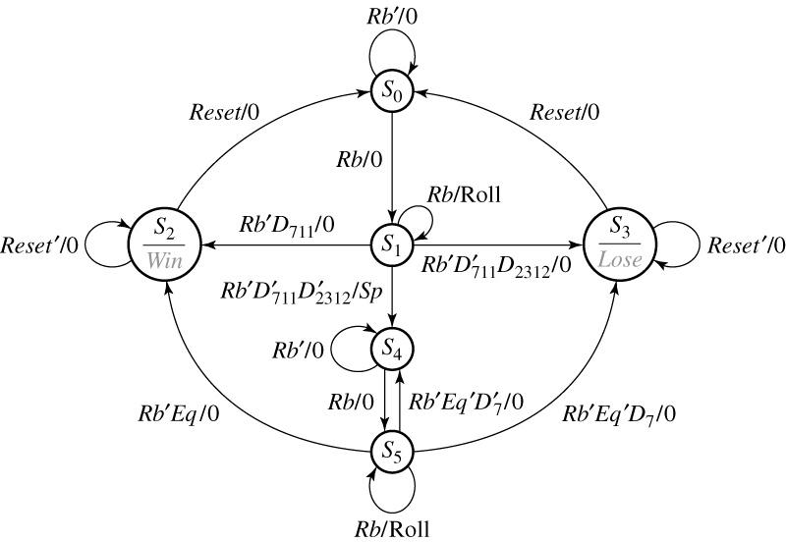
19.2 Derivation of SM Charts
Figure 19-14: State Graph for dice Game Controller

Slide 20
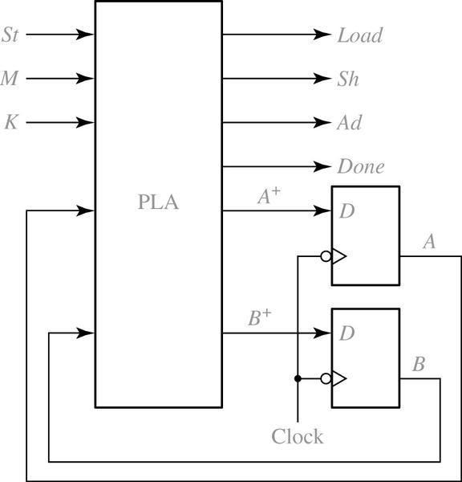
19.2 Derivation of SM Charts
Figure 19-15: Realization of figure 19-10 Using a PLA and Flip-Flop

Slide 21
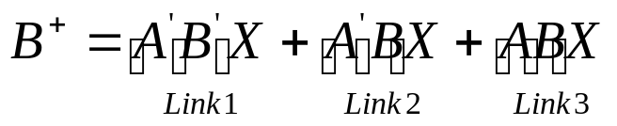




19.3 Realization of SM Charts
Similarly, two link paths terminate in a state with A=1, so
Identify all of the states in which Q=1.
For each of these link paths that lead into the state.
For each of these link paths,find a term that is1 when the link path is
followed. That is,for a link path from to ,the term will be 1 if the
machine is in state and the conditions for existing to are satisfied
4. The expression for (the next state of Q)is formed by Oring together
the terms found in step 3.

Slide 22
19.3 Realization of SM Charts –cont’
Before driving next-state and output equations from an SM
chart, a state assignment must be made.
After a state assignment has been made, output and next-state
can be read directly from the SM chart.

Slide 23
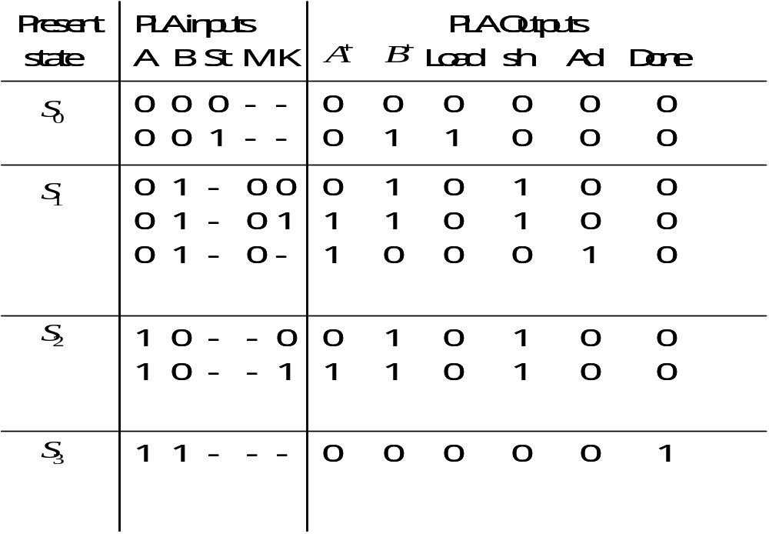
19.3 Realization of SM Charts
Table 19-1 PLA Table for Multiplier Control

Slide 24
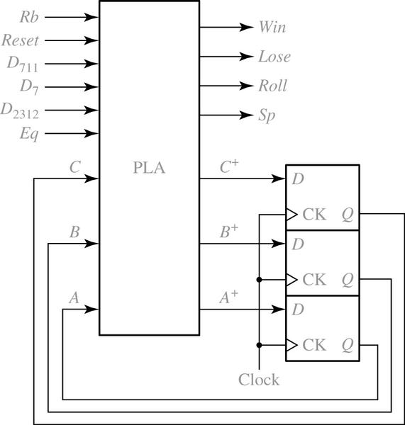
19.3 Realization of SM Charts
Figure 19-16: PLA Realization of Dice Game Controller

Slide 25
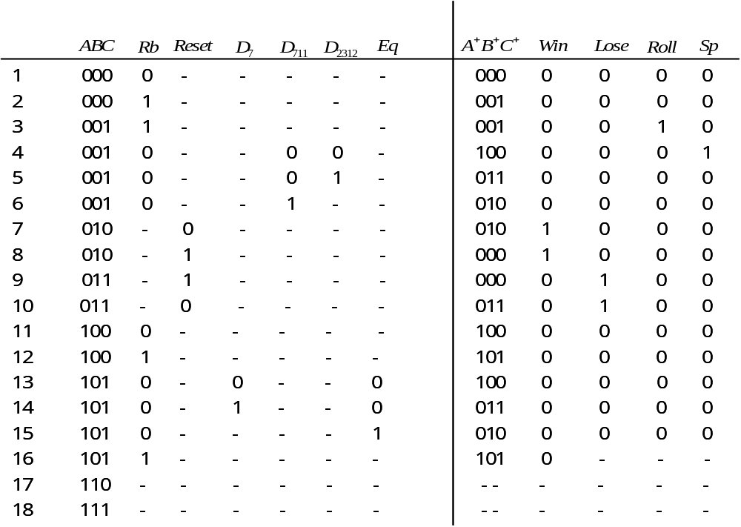
19.3 Realization of SM Charts
Table 19-2 PLA Table for Dice Game

Slide 26
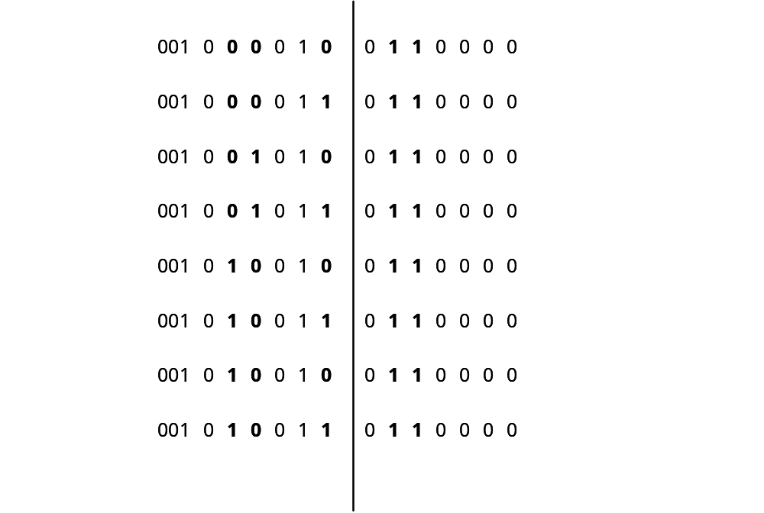
19.3 Realization of SM Charts
For example, row 5 would be replaced with the following 8 rows:
The added entries have been printed in boldface

Slide 27
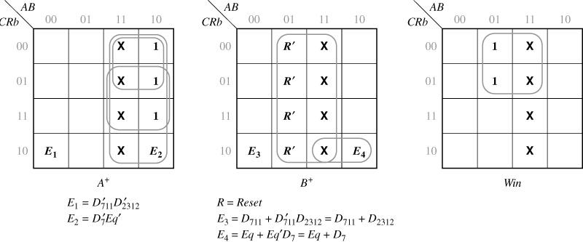
19.3 Realization of SM Charts
Figure 19-17: Maps derived from Table 19-2
** Because A+B+C+ and Rb have assigned values in most of the rows of the table, these four variables are used on the map edges, and the remaining variables are entered within the map.**

